Slide 1
Introduction
Although Pakistan achieved independence through a constitutional means on the basis of 1945-46 elations, however, after getting independence it hardly followed a constitutional way leading to the electoral politics. No general elections on the basis of adult franchise could be held till 1970.

Slide 2
Background
The authoritarian rule of the ruling party Pakistan Muslim League (PML) avoided going for elections due to their declining popularity against other regional and linguistic political forces of the country.
President General Ayub Khan, in order to re-elect himself, hold indirect elections on the basis of Basic Democracy.

Slide 3
Background
The first ever general elections on the basis of adult franchise was held by General Yahya Khan. By avoiding his personal intentions to get himself re- elected as the head of state in case if no one could get clear cut majority.
Yahya khan got the credit to held the first ever general elections in the constitutional history of Pakistan

Slide 4
Why Yahya Khan agreed to arrange election?
It has been often suggested that the army believed that the elections would see the emergence of a large number of political parties in the Assembly.
Thus, no party would have a commanding majority; thereby leaving the initiative in the hands of the President and the emergence of coalition government

Slide 5
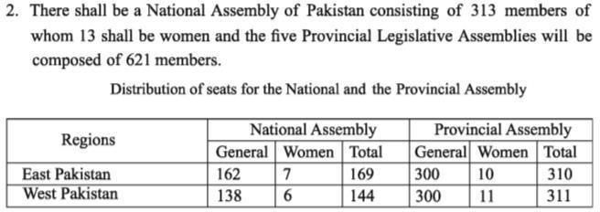
The Legal framework order :
On 28 March, 1970, Yahya Khan announced the basic principles of the legal framework order relating to election.
The LFO also dissolved the "One Unit" scheme of West Pakistan
Pakistan would be a democratic country and the complete name of the country would be the Islamic Republic of Pakistan
National Assembly of Pakistan will consist of 313 seats with 13 seats reserved for women.

Slide 6
The LFO also dissolved the "One Unit" scheme of West Pakistan
Pakistan would be a democratic country and the complete name of the country would be the Islamic Republic of Pakistan

Slide 7
169 seats were to be for East Pakistan, 85 for Punjab, 28 for Sindh, 19 for NWFP, 5 for
Baluchistan and 7 seats were allotted to the tribal areas.
Legislatures shall be elected through direct elections on the basis of population and adult franchise.
Within a specified period, economic and all other disparities between different provinces and areas shall be removed.
The independence of the judiciary shall be secured.

Slide 8

On July, 1969, as per the announcement of Yahiya Khan , an Election Commission
was formed which was headed by Supreme Court.
Election Date:
justice Abdus Sattar, a justice of Pakistan
Assembly | Previous Date | Changed Date
National Assembly | October, 5 | December, 7
Provincial Assembly | October, 22 | December, 17

Slide 9
Why Election Date changed?
The elections were originally scheduled for October 1970, but the devastating cyclone in East Pakistan upset the plans.
This worst natural calamity killed, according to the official estimate, over 200,000 persons (and unofficially about five times that figure)
Affected over three million people and destroyed 90 per cent of the crops and houses in 3,000 square miles

Slide 10
1970 Flood
No warning had been issued in these areas although there was a storm warning system in East Pakistan.
The relief operation was
slow and the deep
inadequate only intensified
anger of the Bengali people

Slide 11
National vs regional
During the election campaign, it became obvious that “national” parties had little grass-root support, while parties with mass support tended to be regional.

Slide 12
Campaign of Political Parties
Campaign of Awami league
The main issue in the election campaign in East Pakistan was the question of provincial autonomy and the political scene from the beginning was dominated by Sheikh Mujib-urRehman of the Awami League.

Slide 13
Awami league got advantage
The Awami League had a fairly sound base in East Pakistan at the advent of elections. However, the boycott of elections by Maulana Bhashani and by the National Progressive League and Krishak Saramik Party in East Pakistan left the League virtually alone in the field.16 Moreover, the traditional parties, like the Muslim League and the Jamaat-i-Islami or the Nizam-i-Islam Party, which set up candidates in both wings, mustered no support in East Pakistan

Slide 14
Campaign Of Pakistan peoples party
Bhutto’s Pakistan Peoples Party was the second ‘winning’ party. His personality, his socialistic ideas and his slogan of Roti, Kapra aur Makan, meaning food, clothing and shelter, were the factors that contributed to the popularity of Pakistan Peoples Party.

Slide 15
Campaign Of Pakistan peoples party
During the
election campaign, the PPP reiterated its
principles:
‘Islam is our faith;
Democracy is our polity;
Socialism is our economy;
all Powers to the people’.
Similarly, the party introduced a new language of politics focusing on the local issues related to the industrial relations, landlord-tenant conflicts and demands from the government that shelter be provided to the working class etc.

Slide 16
Rightist parties
Muslim Jamiat Islami.
league, Jamiat Ulema-i-Pakistan
Ulema-i-Islam, and Jamaat-i-
The rightist parties, at
this occasion, and denounced
propagated their views
their opponents’ programmes especially in regard to socialism and regional autonomy.

Slide 17
Election result
The elections of 1970 resulted in an
Sheikh Mujib’s
overwhelming victory for
Awami League in East Pakistan. The Awami League won an absolute majority in the National Assembly by securing 160 out of 300 seats.
Awami league also secured all 7 reserved seat for women.

Slide 18
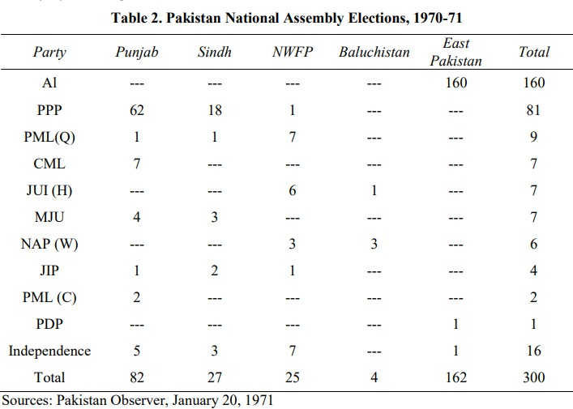
Election Result

Slide 19
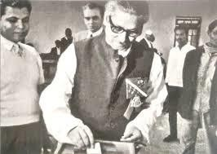
Total
Parties | Seats
Awami League | 167
Pakistan People's Party | 88
Other Parties | 44
Independents | 14
TOTAL | 313

Slide 20
Provincial Assembly
Awami League’s strength in the East Pakistan Assembly was 288 out of 300 seats but it had no representation in the provincial Assemblies in West Pakistan.

Slide 21
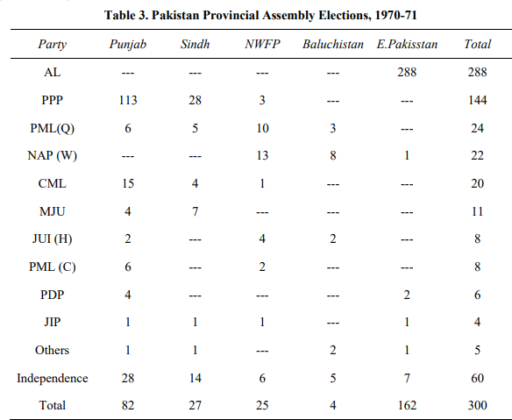
Provincial Assembly

Slide 22
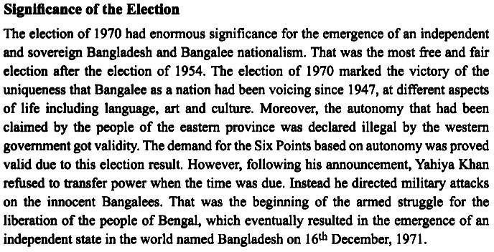

Slide 23
https://youtu.be/YzrAMfpQIL0?si=TyK53Zo4z9uM6pq1

Slide 24
Thank you

